Slide 1

EAST WEST COLLEGE OF ENGINEERING DEPARTMENT OF COMPUTER SCIENCE AND ENGINEERING
Under the guidance of
SCALABLE CONTINUOUS INTEGRATION-CONTINUOUS DEPLOYMENT
G R VISHAL (1EE16CS011)
POORNIMA Y O (1EE16CS022)
HARSHITHA S (1EE16CS015)
SUBRAMANYA DATTA S(1EE16CS044)
Prof. CHETHANA R M

Slide 2
CONTENTS
1.
Introduction
5.
Implementation
9.
Future Enhancements
2.
Literature Survey
6.
Screenshots
10.
References
3.
Software Used
7.
Advantages
4.
Methodology
8.
Conclusion

Slide 3

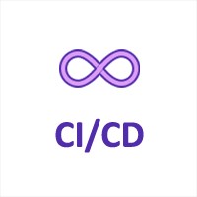
INTRODUCTION
Quality and Time-To-Market (TTM) are crucial factors for the success of any software product. This can be achieved with Continuous integration and Continuous deployment (CI-CD)by using various ‘Development-Operations’ (DevOps) tools.
CI-CD is an emerging field in the industry where many companies lack this implementation. Only renowned organizations like Google, Microsoft and other major players are having full-fledged CI-CD setup at place. Rest of the organizations are still struggling go get there.

Slide 4
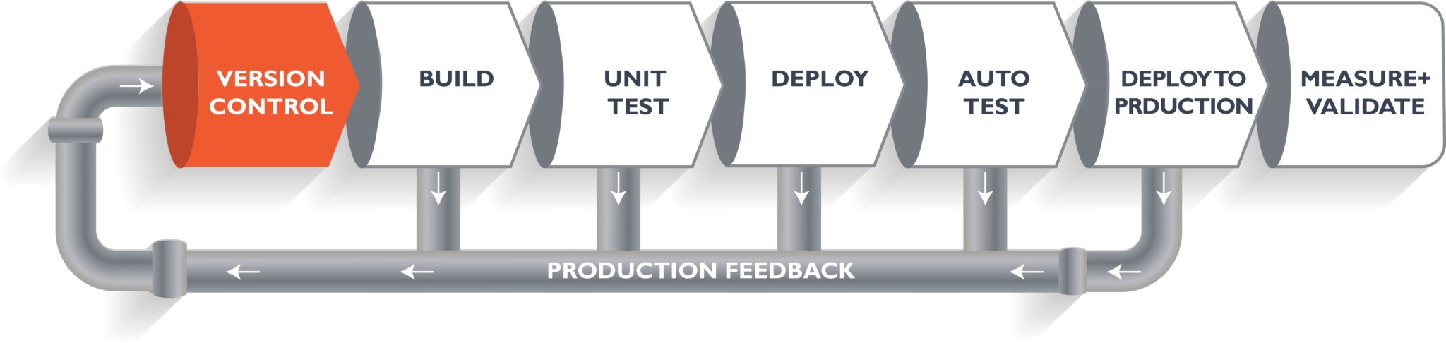
What is DevOps Pipeline ?

Slide 5
Literature Survey
DevOps was seen not just a change in processes but a major change in culture of software development. Also, it presented how gaps surrounding continuous deployment to integrated software be reduced to minimum.
According to the 2017 State of Devops Report, high performance companies like Amazon and Netflix deploy thousands of times per day. Configuration management allows the rollback of previous code for the developer.
However, several factors prevent the organizations from adopting these approaches like lack of fully automated acceptance test, poor rollback methodology, manually driven quality check etc.

Slide 6
Existing System
Task | Time in day(s)
Installing different software set on 100 different machines. | 2
Bringing production server up when it goes down | 1
Checking the quality of the software - Scan the deliverables like docker images via different tools. - Manual verification of the results. | 1
Running the tests on 100 machines without auto scale | 2
Get product statistics from various sources, collect all test results and consolidate all this information into one. | 1
In practice, any human error leads to further delay, which is omitted from the above estimation chart.

Slide 7
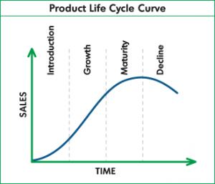




Disadvantages of Existing System
Existing systems either did not adapted DevOps or not using DevOps framework to its full potential. Below statistics leads to:
Delay in the Time To Market of the product.
Quality of the product.
Vulnerabilities
Product security.
Prone to human errors

Slide 8
Proposed solution
Bringing 7 days of labor to 1 day is possible with the best use of various DevOps technologies and tools available in the industry under one umbrella. Our ‘Scalable CI-CD using Devops addresses different stages of problem statement is described below:
Problem Statement | Proposed solution
Deliver the features developed into source archive, from different teams across the globe. | Use ‘Git’ as source archive, where teams across the globe can deliver the changes at any time.
Test the quality of the code via unit tests, integration and automated tests. (Testability, maintainability, scalability and security aspects to be covered). | Use Nunit, Mstest, Jmeter to run unit/automated tests.
Test across different environments (different Operating systems, browsers and software set combination). | Use Virtual machines (VMs) with AWS-cloud combination to pull various operating systems to host different sets. This technology is new to the industry. This is scalable on need basis, automatically pulls as many VM’s are required to complete activities in stipulated time.
Promote to the production servers | Check the quality history of the product and automatically push to the production.

Slide 9
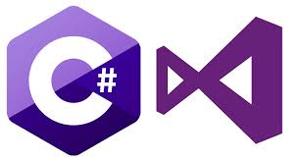
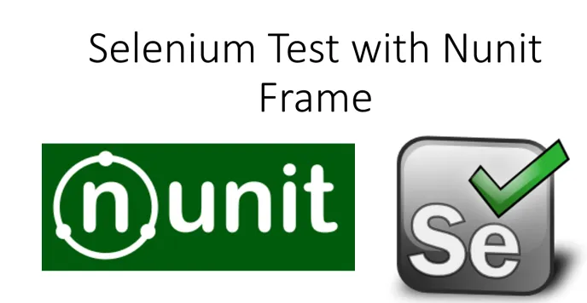
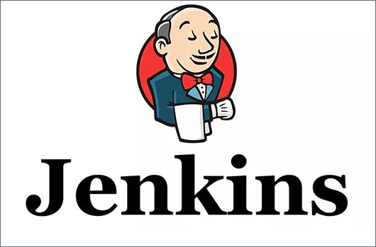

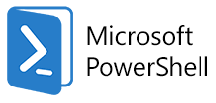
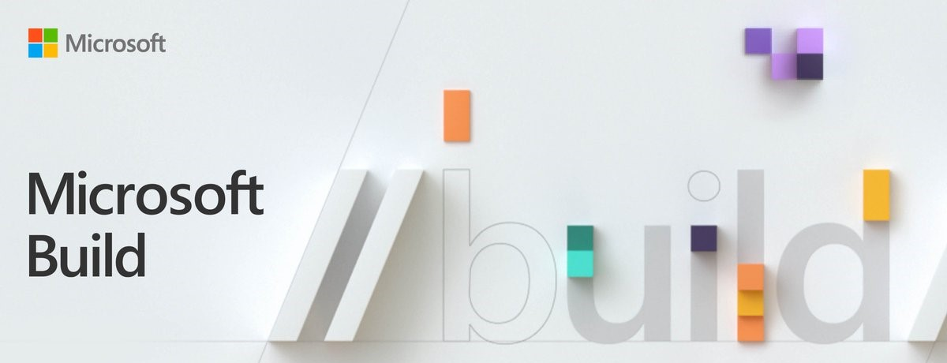
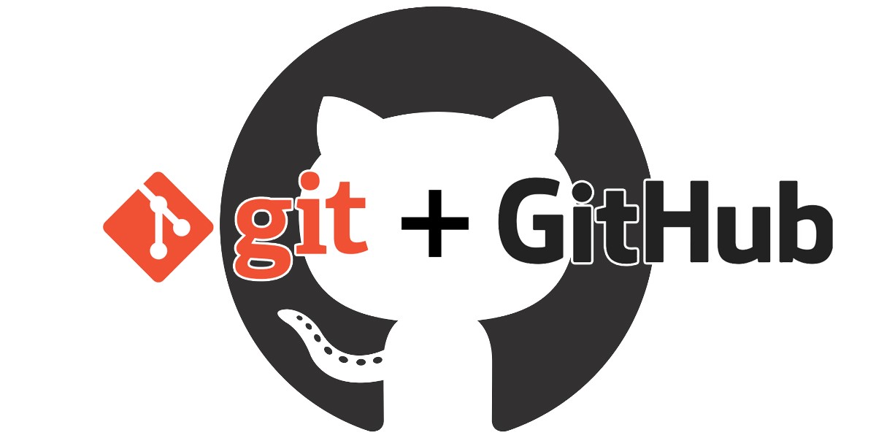
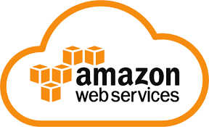

Software's Implemented
PROGRAMMING LANGUAGE & IDE
TESTING FRAMEWORK
AUTOMATION SERVER
ARTIFACTORY MANAGER
BUILD TOOL
VERSION CONTROL SYSTEM
CLOUD COMPUTING PLATFORM
SCRIPTS USED

Slide 10




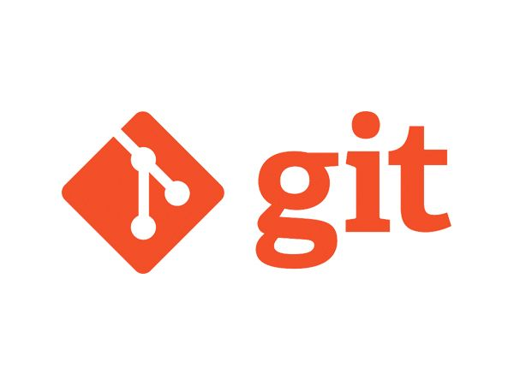

Developers
METHODOLOGY
BUILD
Automation
Version Control
Deploy
Test

Slide 11
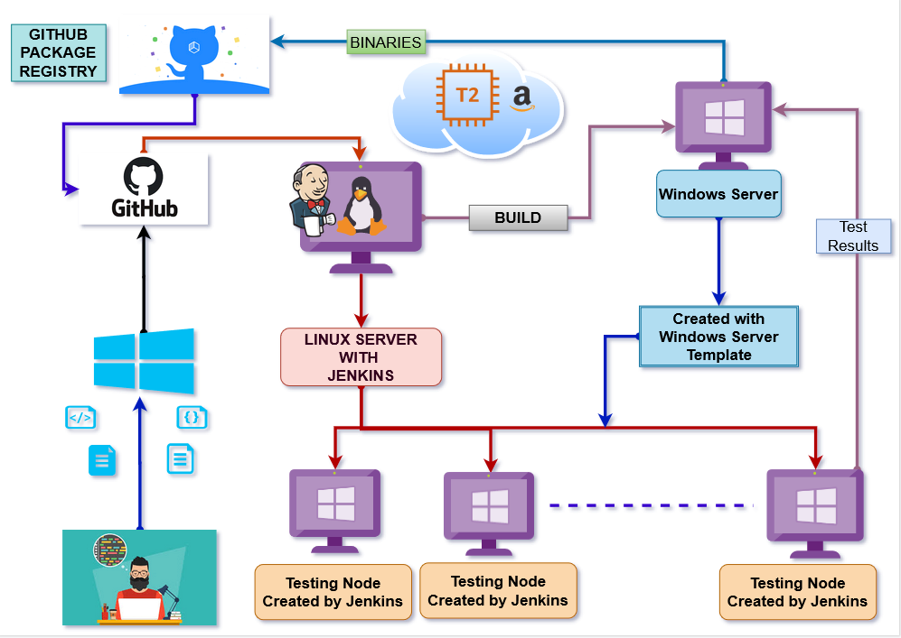
Implementation

Slide 12
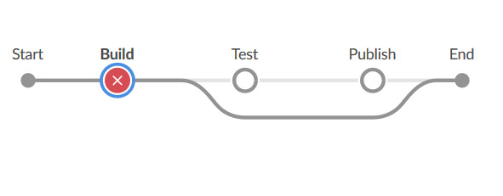
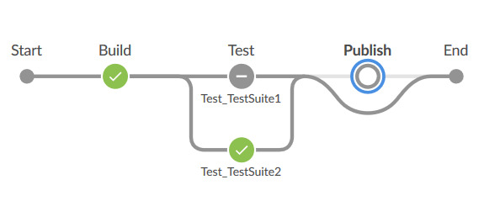
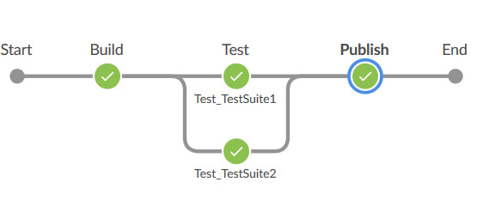
Jenkins Execution
Build fails
One of the test suits fails then publish is skipped
Pipeline successfully executed

Slide 13
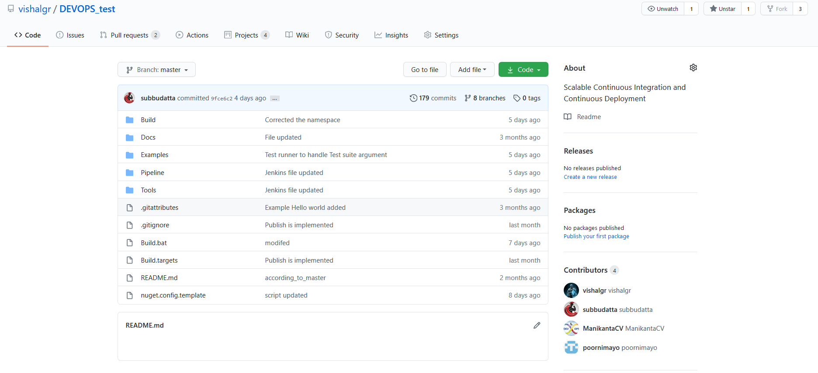
Screen Shots
1.GitHub Repository

Slide 14
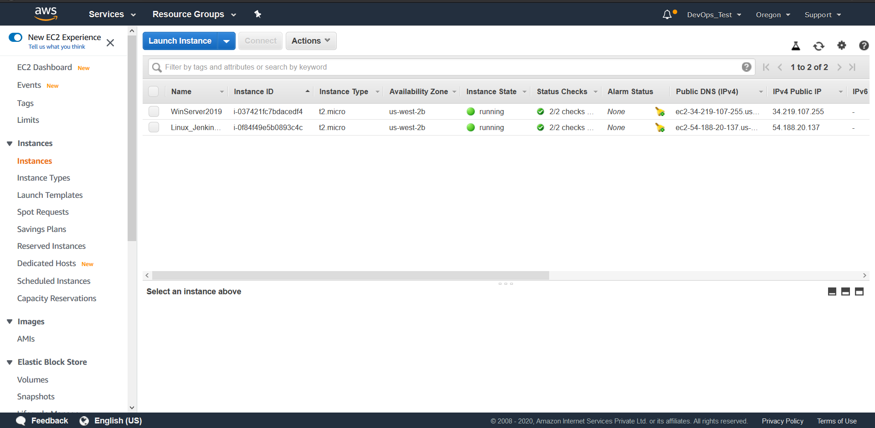
2. AWS Instances View

Slide 15
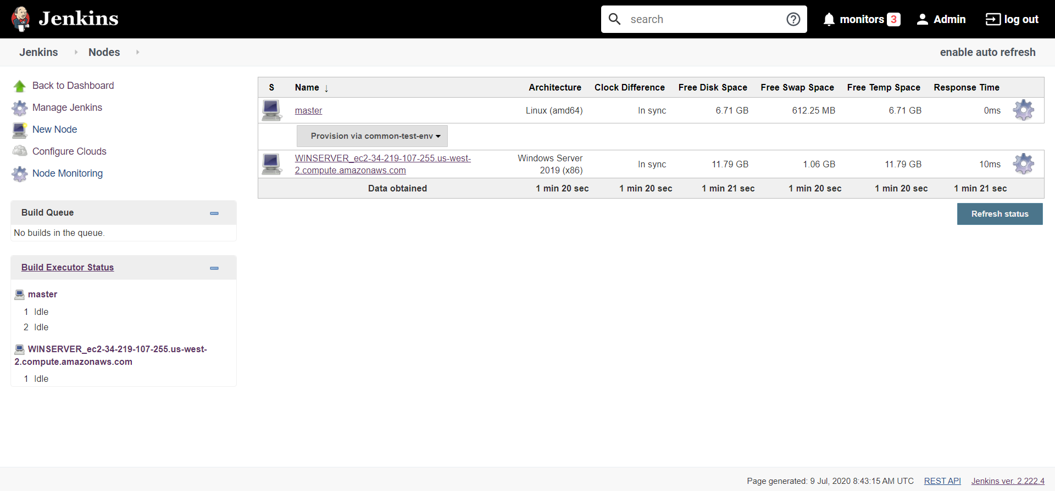
3.Jenkins Nodes View

Slide 16
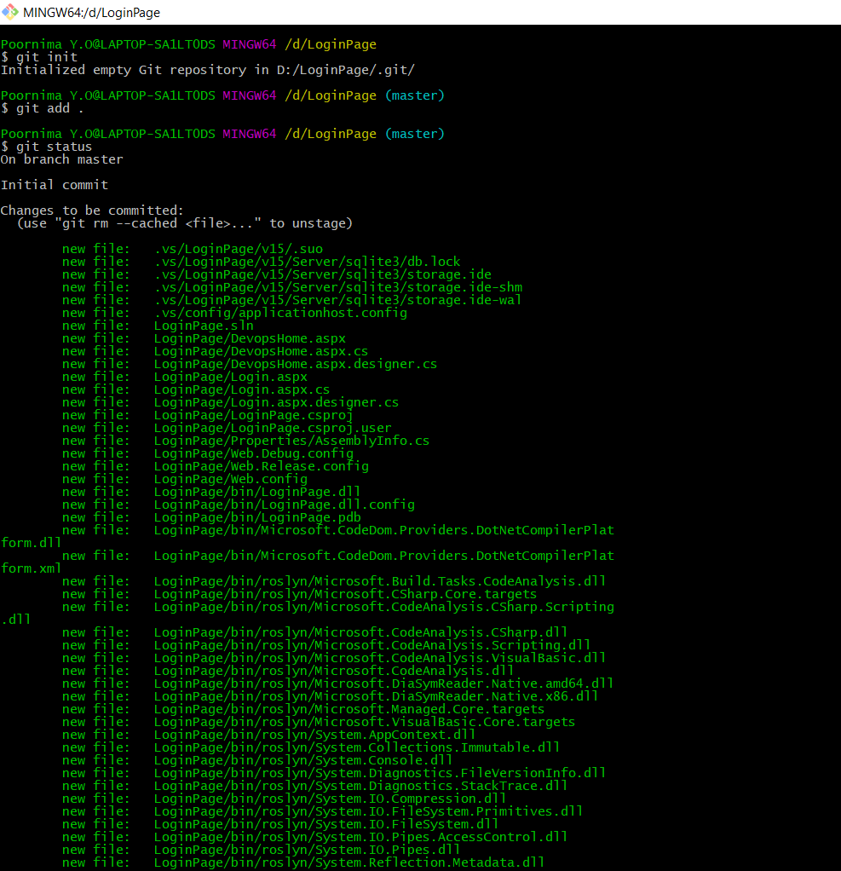
4.Git Bash Terminal

Slide 17
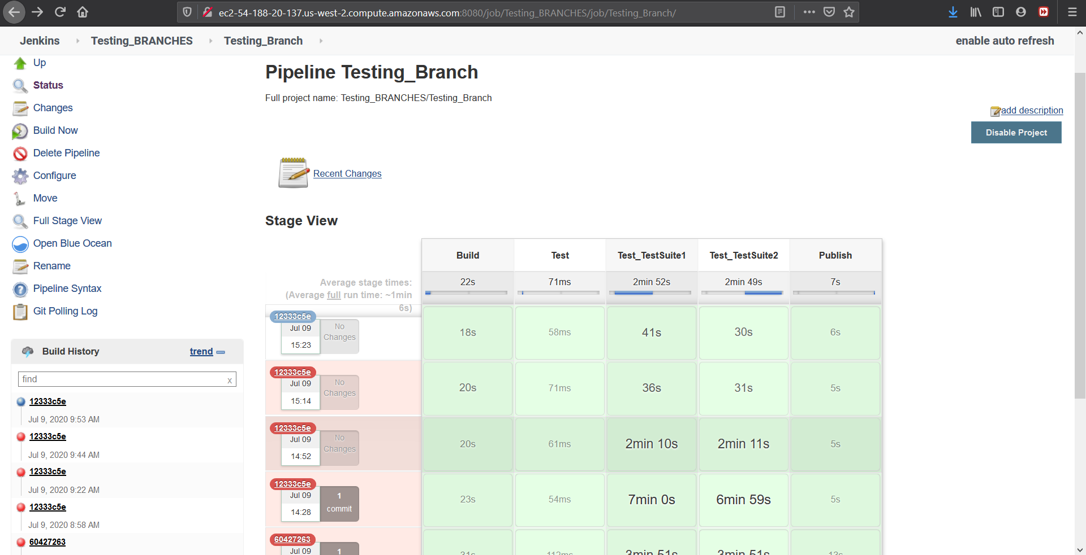
5. Jenkins Pipeline View

Slide 18
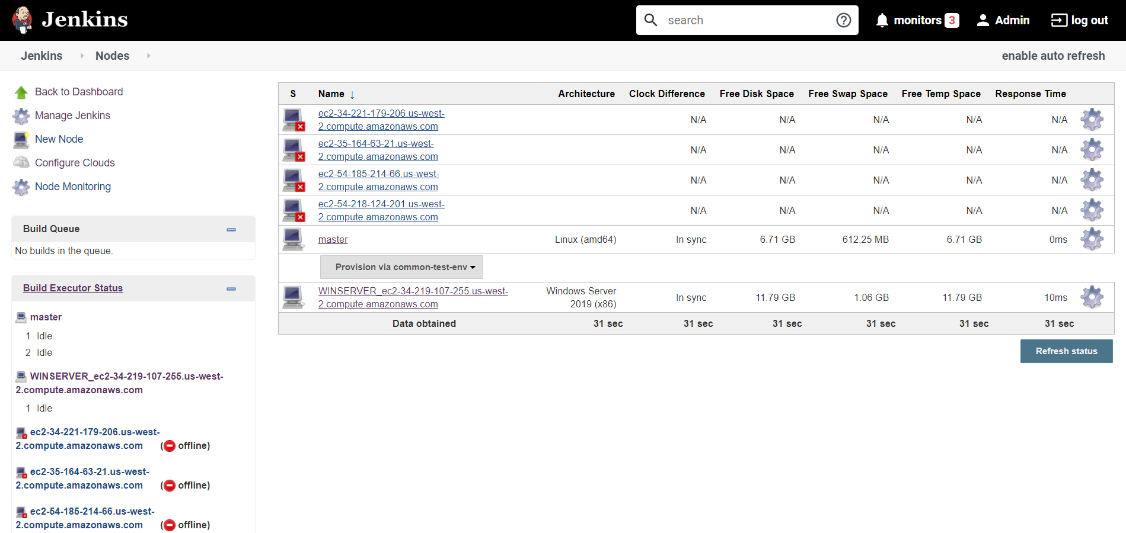
6.Nodes Triggered By Jenkins job

Slide 19
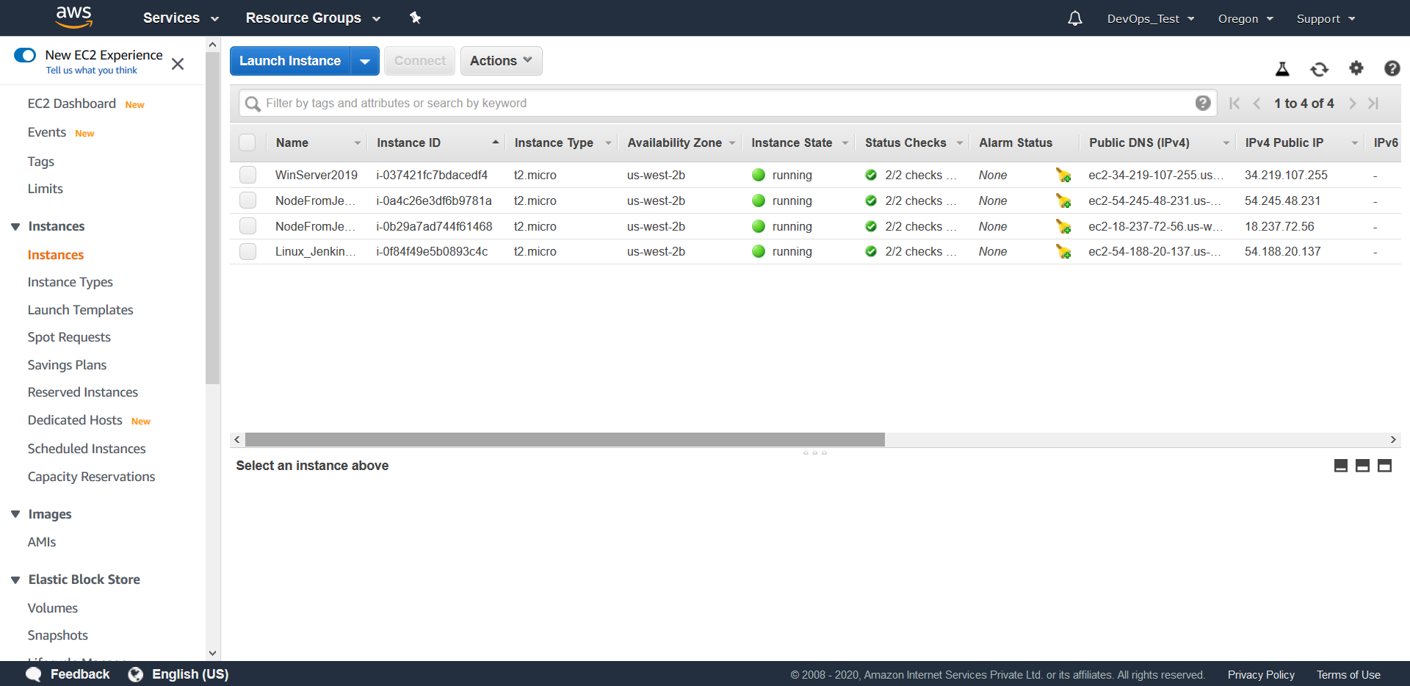
7. AWS Nodes View after nodes triggered by Jenkins

Slide 20
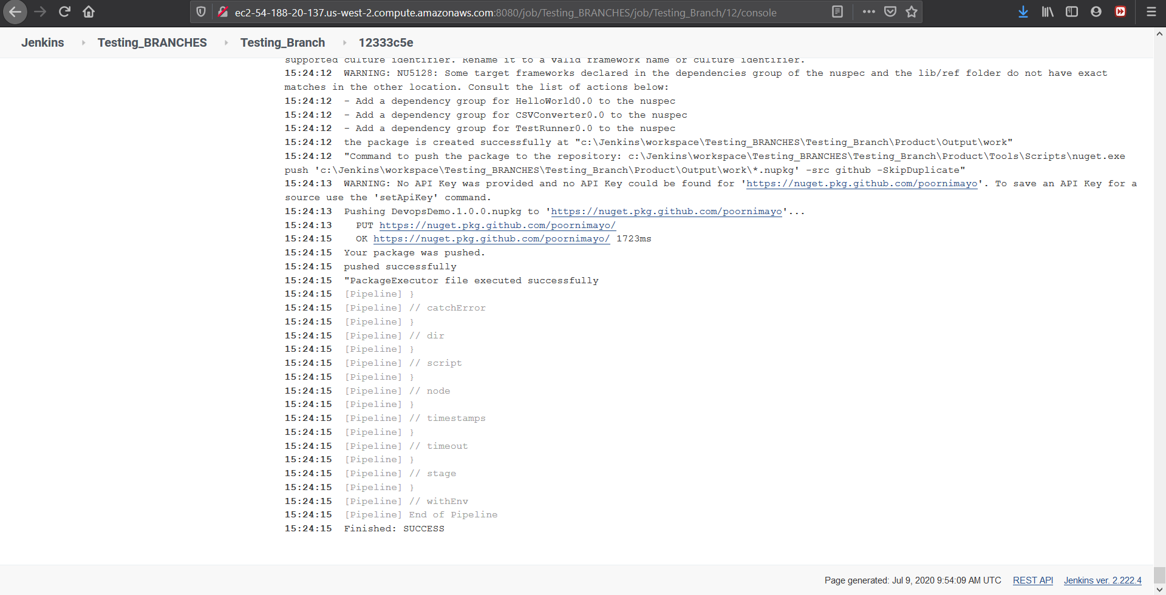
8.Jenkins Console View

Slide 21
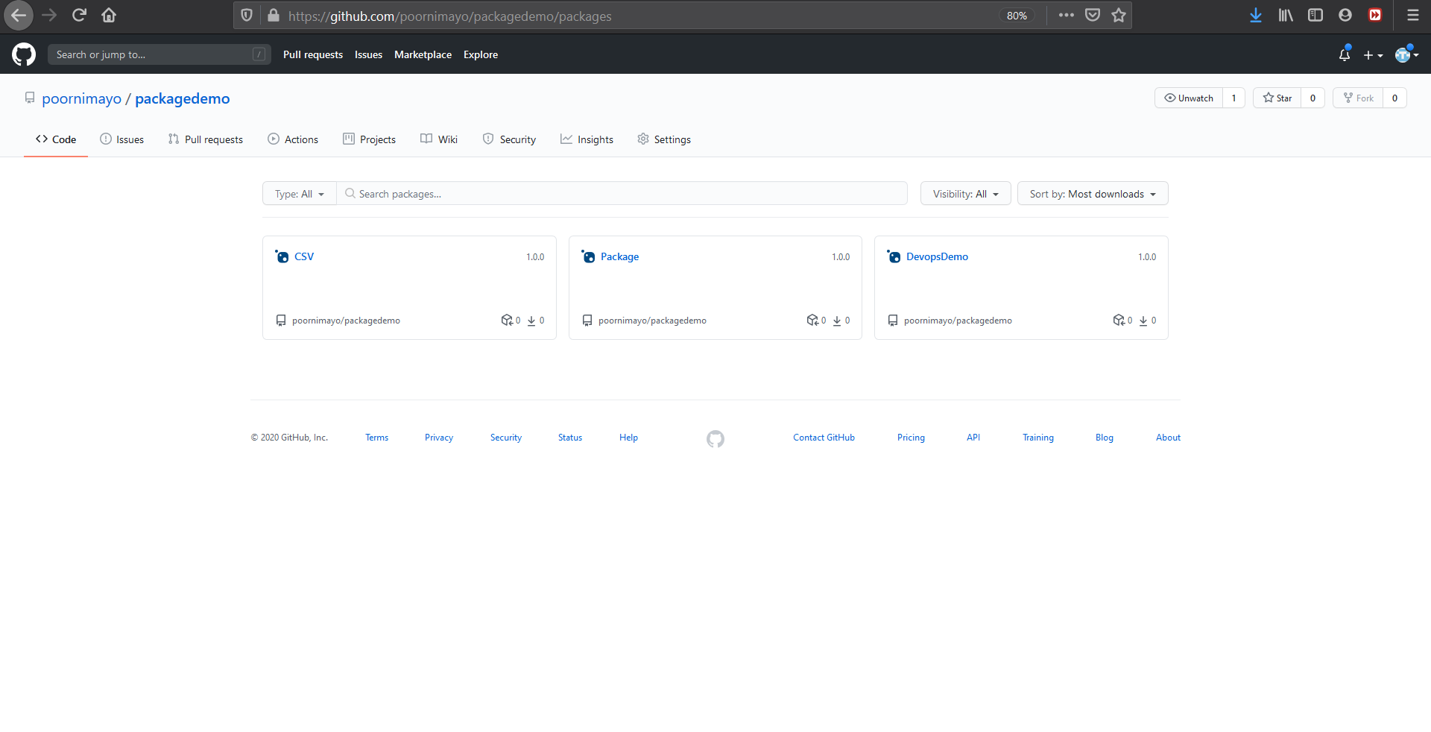
9.Package Registry

Slide 22
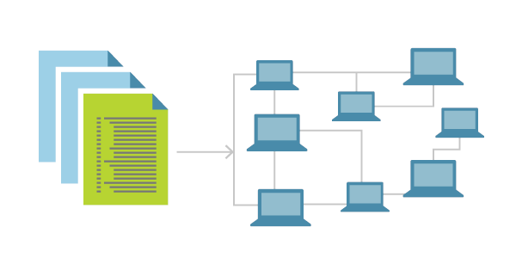
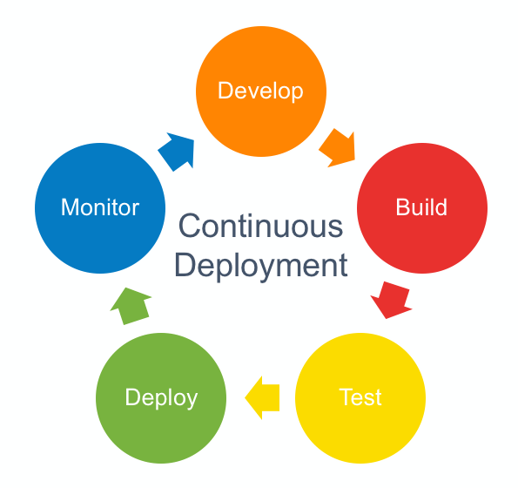


Advantages
In abstract view the CI-CD pipeline setup with DevOps tools brings in below into the development practices.
Infrastructure as a code
Continuous deployment
Automation
Monitoring and Visibility

Slide 23
Conclusion
A software industry without DevOps setup is unimaginable. Setting up CI-CD pipeline is bringing in various heterogeneous tools together and getting the best out of it to achieve the high quality product with quickest possible time to the market. Our proposed solution is generic in nature, address the core issues in product development-delivery lifecycle and suits any organization at any scale.
DevOps is the way to make both developers and customers happy.

Slide 24
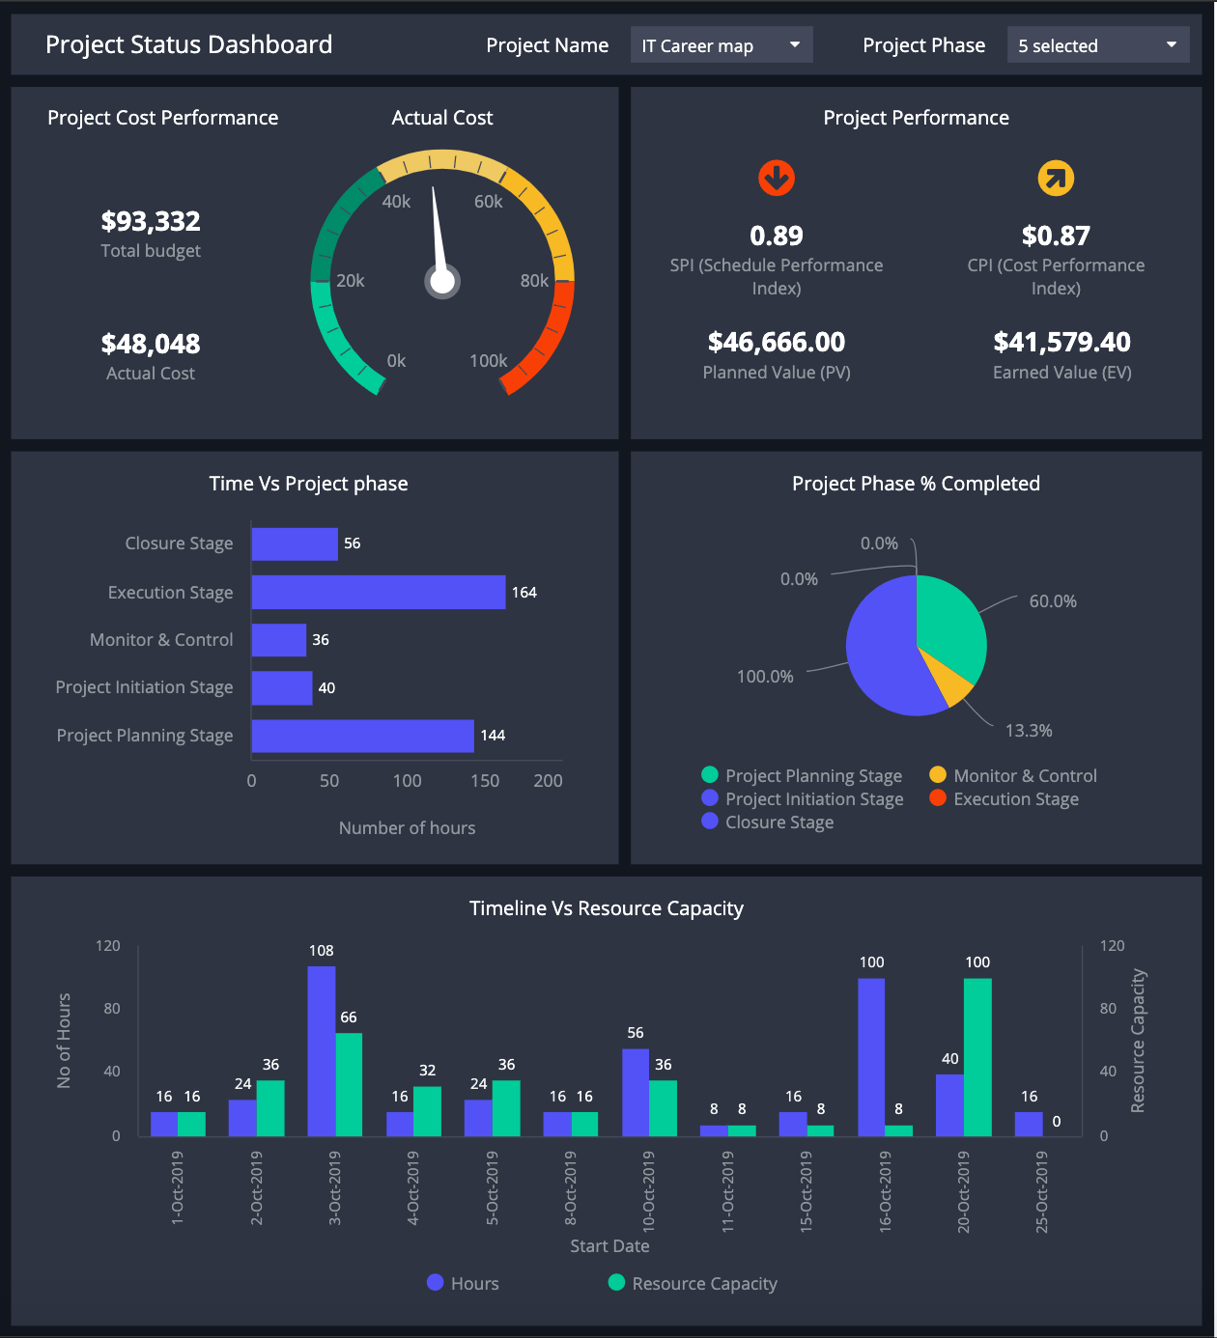
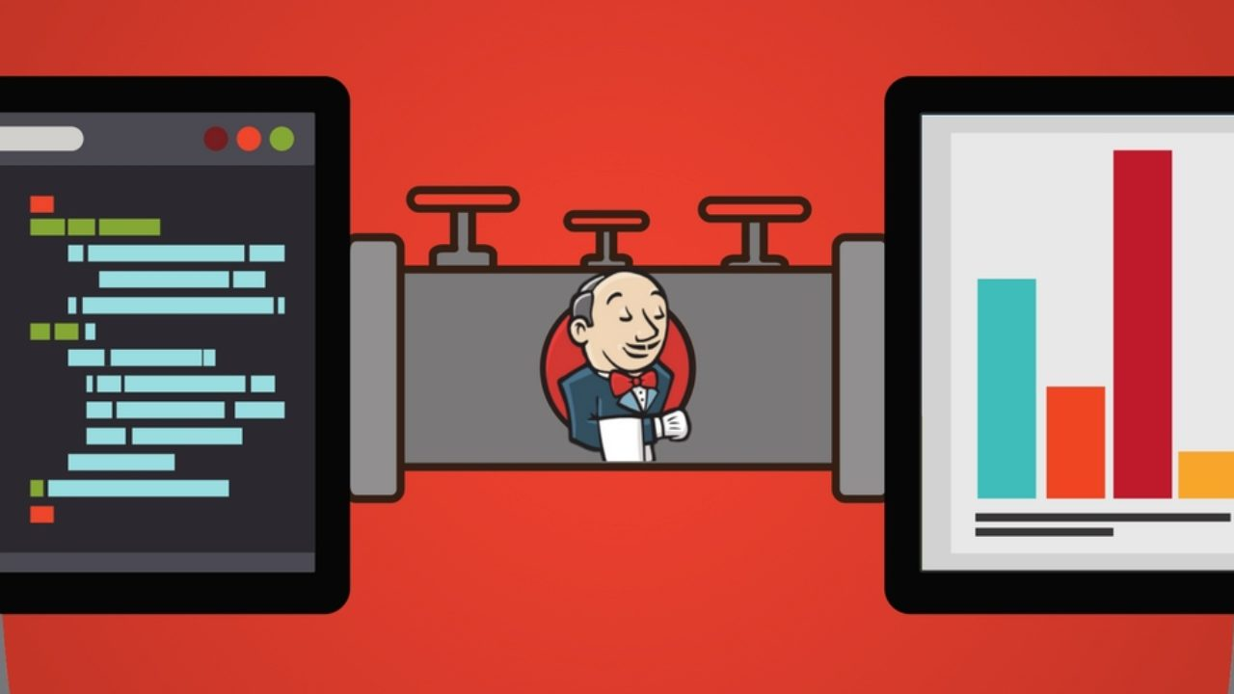
Future Enhancement
Dashboard
Emails via Jenkins

Slide 25
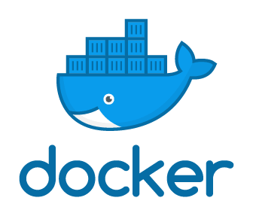
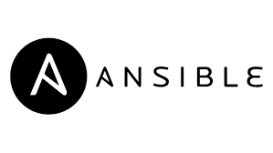
Use Of Docker Containerization
Configuration Management

Slide 26
References
GitHub Repository URL : https://github.com/vishalgr/DEVOPS_test.git
[1] https://dzone.com/articles/focus-on-cicd?fromrel=true
[2] https://cloudtweaks.com/2019/05/devops-secure-and-scalable-ci-cd-pipeline-with-aws/
[3] https://github.com
[4] https://signin.aws.amazon.com
[5] https://www.google.com/
[6] https://www.jenkins.io/
[7] https://github.com/features/packages
[8] https://visualstudio.microsoft.com/

Slide 27



